Slide 1


STORM GUARD
Ivan Muzondiwa
ST10455309

Slide 2

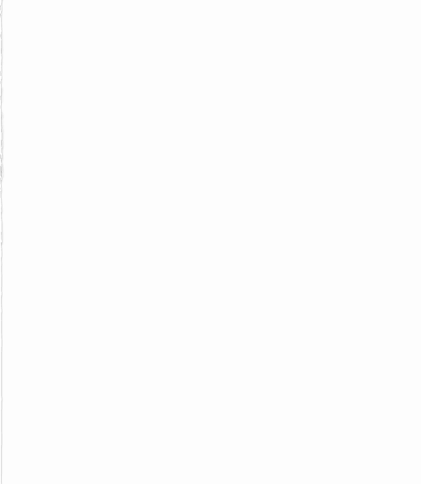
Purpose
“Storm Guard”.
Storm Guard is a weather application used for local weather. This application provides the average temperature for the week and permit users to view detailed information for each day.
This application is designed to manage weather conditions weekly.

Slide 3

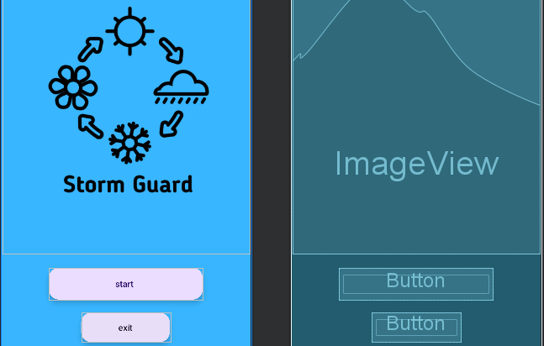
Page 1
As you open the app you are greeted with this front page with the logo and two buttons,
“Start” used to start the application and go to the next page.
“Exit” to leave the application if pressed.

Slide 4
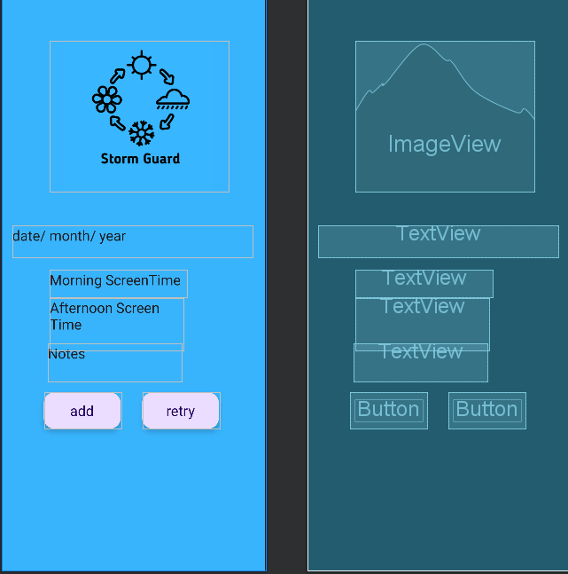
Page 2
After pressing the start button u are brought to the second page where you enter the date and Screen times and your notes obtained.

Slide 5

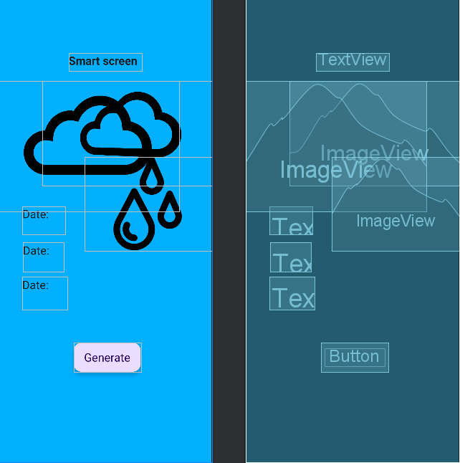
Page 3
This is the 3rd and final page, where you can cucullate the Average, Total and weather.
With the use of the button “Generate”

Slide 6

The layout is simple to navigate, allowing the user to easily operate the app.
The app covers every essential aspect. The application lacks superfluous interface components.
The app contains text that can be seen. The text is easily readable by the user. The application's text is easily understood, with straightforward communication between the user and the app. The title is displayed in the “text appearance” “Display 1” same as all the other buttons.
Make Interface Elements Clearly Visible
Even in bright sunlight and in darkness, the user can easily view all the elements on the screen.
The buttons are placed in a way that allows users to navigate easily. The buttons are designed to be within easy reach of the thumb, as many individuals primarily use one thumb to operate their phones.
The images I used are AI-generated which best describe and portray a virtual pet.

Slide 7
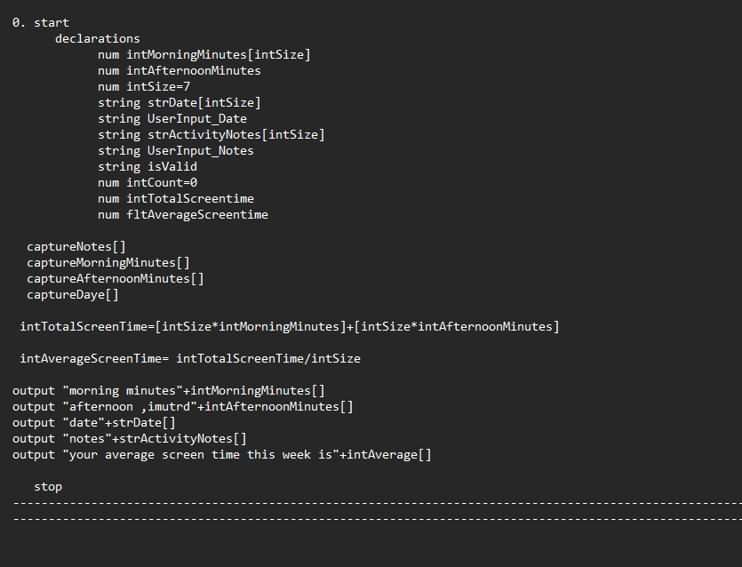

Pseudocode

Slide 8
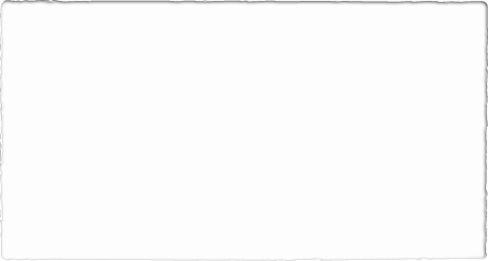

Thank you

